Slide 1


Datathon 3.0
Team Neu_robi_ology

Slide 2

Group Members
Md Farhan Ishmam
Deeparghya Dutta Barua
Fariha Tanjim Shifat
B M Nishanul Alam Nishat

Slide 3
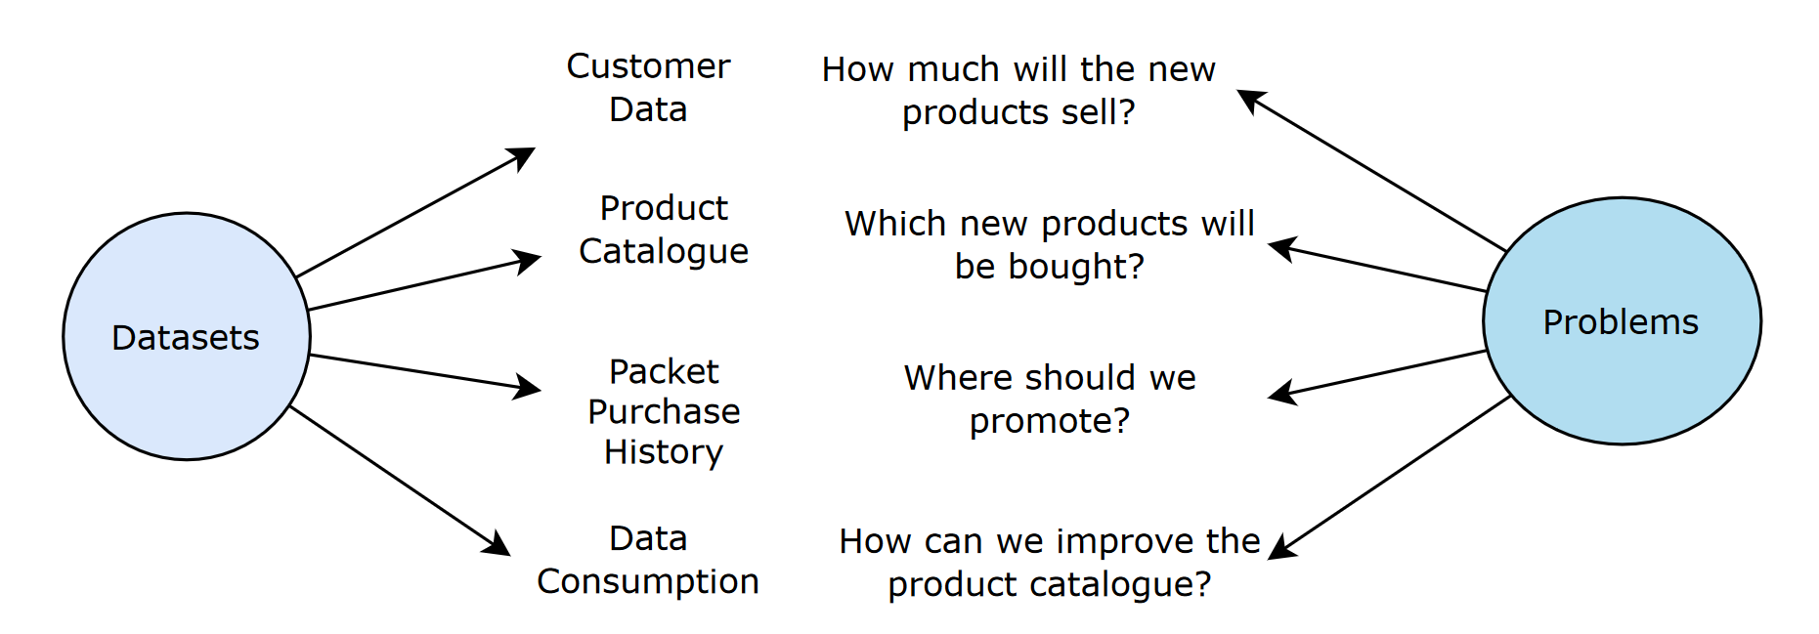
The Datasets and The Problems

Slide 4
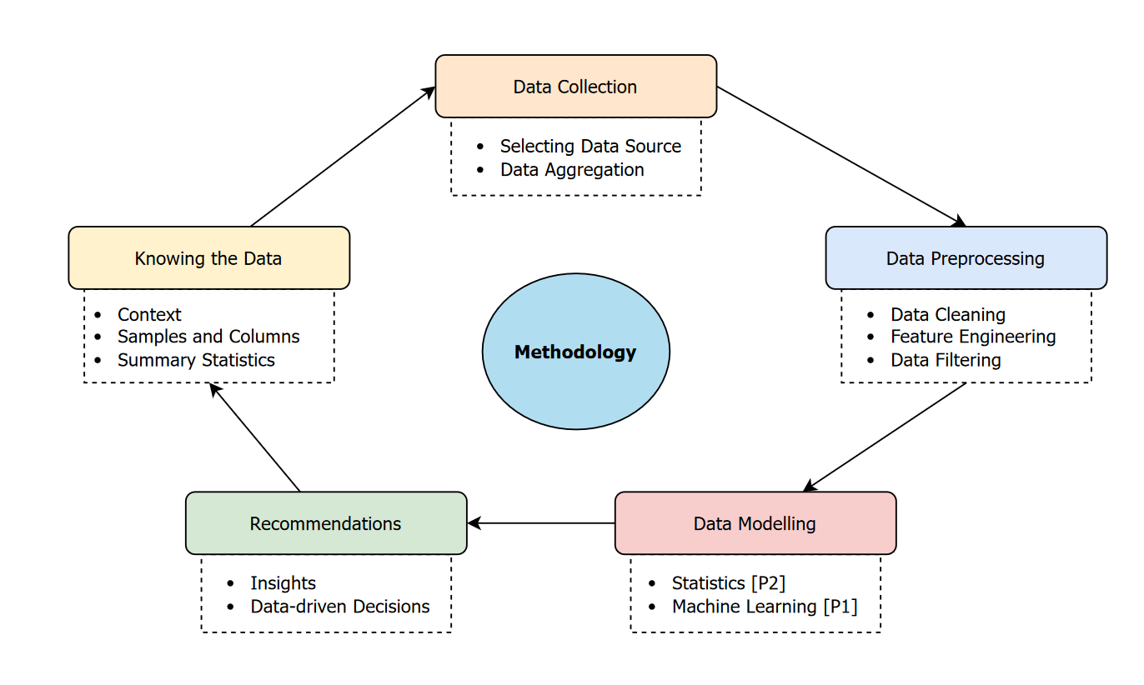

Slide 5
Diving into the Data
Insights on the new products

Slide 6
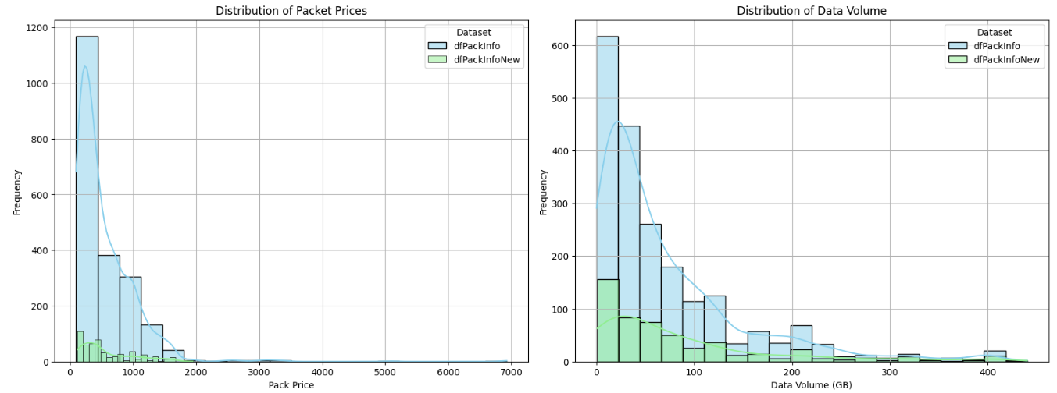
How do new packets vary from continuing packets?
Insight: High data consumption. Enterprise Users?

Slide 7
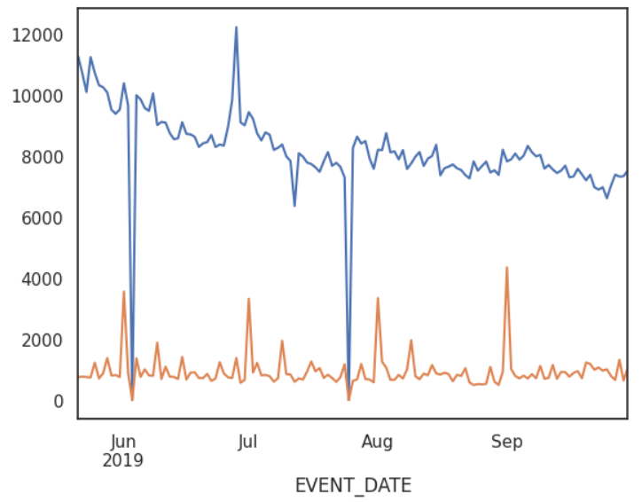
Which new product will the customers purchase?
Our top-ranked model based on statistical analysis, concluded that most of the continuing products will be purchased.
Continuing products show stable purchase trends.
Recommendation: Emphasize on product promotion.
Sales of packages, stratified using product status

Slide 8
Where to promote the products using billboards?
Prioritize:
Exposure to billboard [e.g.during traffic]
Spectators are potential customers [target hot zones]
Good network coverage in that area
Limited public data on billboard location in Bangladesh
Our layers of data:
Population Density
Traffic Data
Network Coverage
Location
Diversity

Slide 9
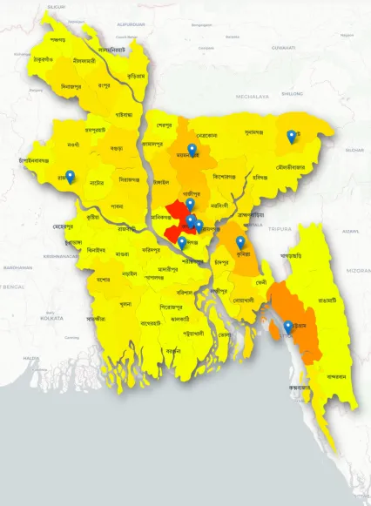
Top 10 places to promote
The map here is colorized based on the population density (red to yellow) and the locations markers are set to show the promotion billboards.

Slide 10
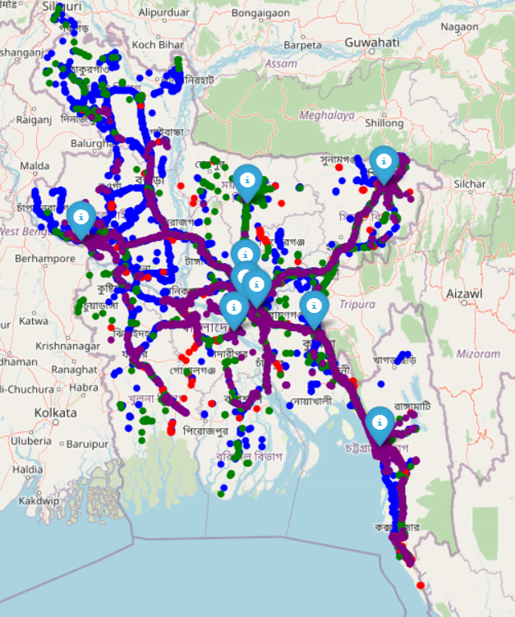
Demonstration
Top 10 locations map: http://10.102.168.116:3000
Top 10 locations with towers: http://10.102.168.116:3006/bangladesh_population_markers_map_1.html

Slide 11
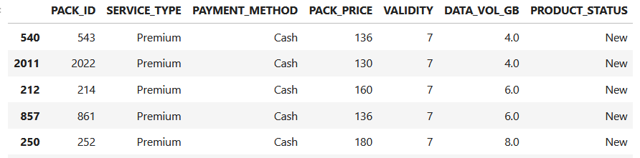
Do identical packets have same price?
Two packets with same properties but different prices.
As many as 10 packets with same properties but different price!
Recommendation: Remove redundant products that increase confusion.

Slide 12
Which Products Should Be Introduced?
Products with similar pricings that offer slightly better perks
For instance:
Pack 1: 400 GB at 299 taka
Pack 2: 360 GB at 250 taka
Pack 3: 240 GB at 150 taka
Which one will the customer buy between pack 1 and 2?

Slide 13
Thank You!
Your insight would be much appreciated.

